Slide 1
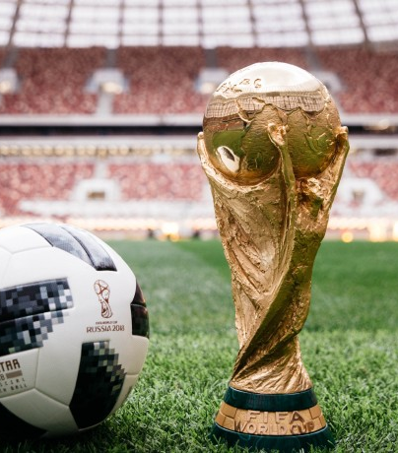
EDA and Logistic Regression on FIFA World Cup 2k18 MADE BY: -AMBER JAIN

Slide 2
PROBLEM STATEMENT
The data set is from FIFA World Cup 2018.
Need to predict whether a team will win or not.

Slide 3
Data Loading and Description
The dataset consist of the information about all the matches played between 32 teams in FIFA world cup 2018. Various variables are present in the dataset includes matches between team(team1 and team2), ball possession, number of red and yellow cards, Goal Scored, Corners, Free kicks, Saves, Passes, 1st Goal, Offsides, Goals in PSO etc.
The dataset comprises of 3456 observations and 27 columns.
FIFA stands for International Federation of Association Football. FIFA was founded in 1904. It is the most popular game across the world. FIFA world cup 2018 was played in Russia and 32 teams qualified for the world cup. 64 Matches was played in the World Cup between 32 teams. 48 Matches was played in group stage and 16 matches was played in knockout games. This tournament is played once in every four year.

Slide 4
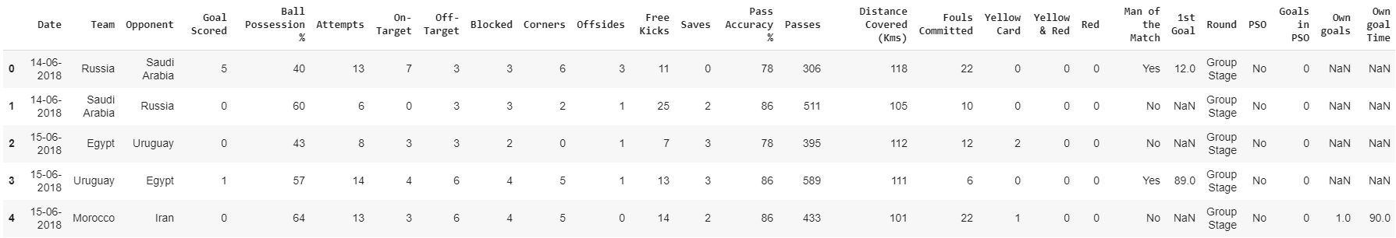
Data in Dataset

Slide 5
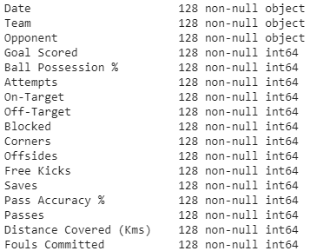
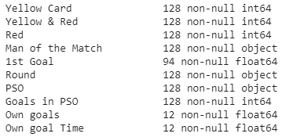
Pre Processing Data
Actual Data
Missing Values
1st Goal column have 34 non null values.
Own goals has 116 non null values.
Own goal time has 116 non null values.

Slide 6
Analysis on missing values
1st Goal: - Have 34 non null values means 34 times team didn’t score a goal”.
Own Goal: - 12 times team scored own goals or in other word 12 times team concede a goal.
Own Goal Time: - 12 times team score own goals so this column contain the time when team score own goal

Slide 7
Teams that played/qualified for FIFA World Cup 2018
Argentina
Australia
Belgium
Brazil
Colombia
Costa Rica
Croatia
Denmark
Egypt
England
France
Germany
Iceland
Iran
Japan
Korea Republic
Mexico
Morocco
Nigeria
Panama
Peru
Poland
Portugal
Russia
Saudi Arabia
Senegal
Serbia
Spain
Sweden
Switzerland
Tunisia
Uruguay

Slide 8


Number of Matches Played
48 matches played in Group Stage.
8 matches played in Pre Quarter Finals
4 matches played in Semi Final
1 match was played for 3rd position(Losers of Semi Finals)
1 match was played for finding World Champions(FINAL)

Slide 9
Some More Analysis on Data
169 number of goals scored in the World Cup.
1906 Free-Kicks taken by team in the World Cup
2 times team members got both red and yellow cards.
8 times team score a goal in Penalty Shoot out i.e., result of match is decided by Penalty Shoot out.
59219 passes taken by team in World Cup
37 number of times team lost the match when ball possession is less than 50%.
28 number of times team won the match when ball possession is less than 50%
27 number of times team lost the match when ball possession is more than 50%
36 number of times team lost the match when ball possession is more than 50%
1734 fouls were committed by teams in World Cup
Belgium, Coatia, England and France played maximum number of matches i.e., 7.
France won all the 7 matches and won the world cup.

Slide 10
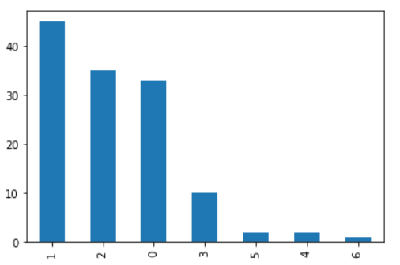
Number of goals scored by a team

Slide 11
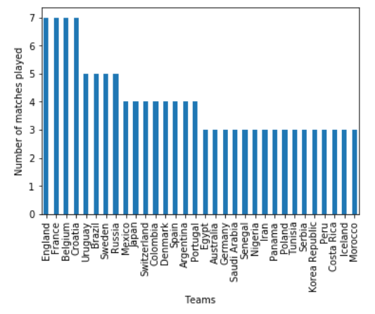
Number of matches played by each team in the World Cup 2018 England, France Belgium and Croatia (7 Matches each)

Slide 12
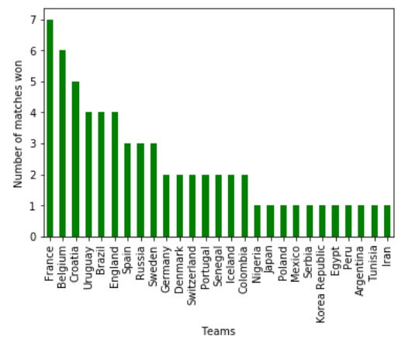
Number of Matches won by each team in World Cup 2018: - FRANCE

Slide 13
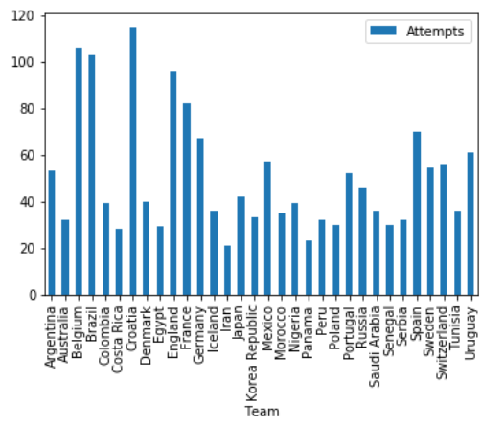
Which team take maximum number of ATTEMPTS to score a Goal? CROATIA

Slide 14
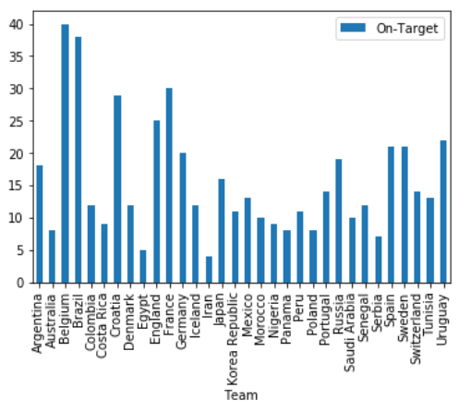
Which team take maximum number of “ON-TARGET” shoots? BELGIUM

Slide 15
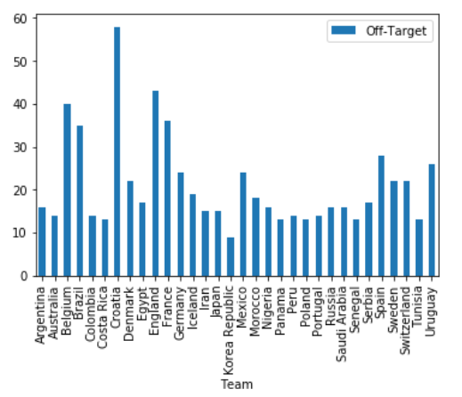
Which team took maximum number of “OFF-TARGET” shoots? CROATIA

Slide 16
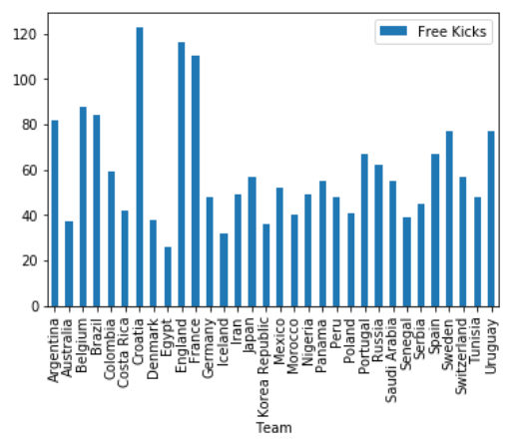
Which team took maximum number of “FREE-KICKS” by team? CROATIA

Slide 17
Which team took maximum number of “FOULS COMMITTED” by the team? CROATIA

Slide 18
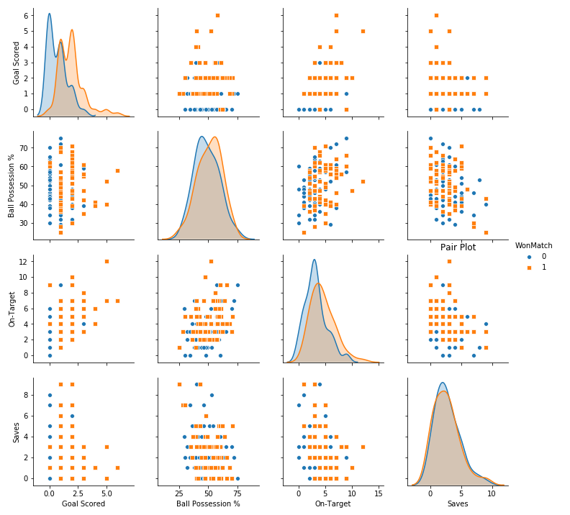
Pair Plot Graph

Slide 19
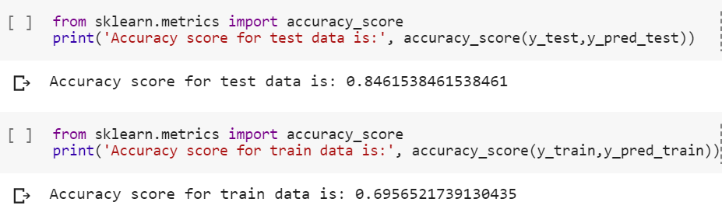
Accuracy on applying Logistic Regression

Slide 20
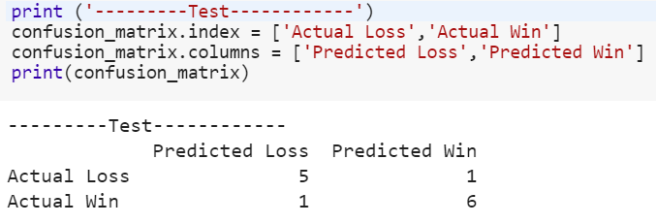
Model Evaluation Using Confusion Matrix

Slide 21
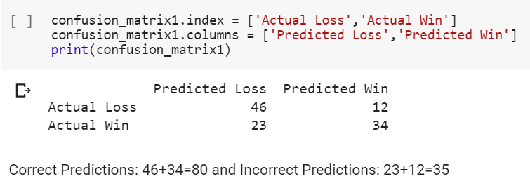
Model Evaluation Using Confusion Matrix

Slide 22

THANK YOU

